Slide 1
Waitlisting @ a Glance
Once waitlisted…
The student can see their position on the waitlist on ASAP.
Faculty can see the positions of all their waitlisted students on ASAP.
The student is notified by email if an open seat becomes available for them.
The student has 24 hours (12 hours during late registration) from the time the email was sent to move from Waitlisted to Registered.
If the student misses the notification window, they can rejoin the waitlist… at the end of the line.
If the student drops from the waitlist or the notification time expires, the next student on the list is notified.

Slide 2
Student view of waitlisting

Slide 3
Waitlisting on the Schedule
Waitlisted Classes are indicated at the time of attempted registration or in the Schedule of Classes.
WL Status Icon to show when class is full but waitlist is available.
Column shows Current Waitlist
N/A = WL not offered for section
# currently on waitlist

Slide 4
Waitlisting on the Schedule
In the Schedule of Classes, the Status Icon will be the easiest way to tell if a student can currently register or waitlist in a class.
There is 1 seat available, but it is being offered to someone on the waitlist. Therefore, the class status is WL.

Slide 5
Waitlisting on ASAP
To get on a waitlist, the student would…
Login to ASAP, and access Registration.
On the Add/Drop Classes page…
Enter the CRN(s) under the Add Classes Worksheet.
Click the Submit Changes button.

Slide 6
Waitlisting on ASAP
OR
If the class is closed/full because it has met its set maximum enrollment but the class has a waitlist, the student will be notified in Status under Registration Add Errors.

Slide 7
Waitlisting on ASAP
To be added to the waitlist for the section…
Select Waitlist from the drop-down list under Action for the class.
Click the Submit Changes button.

Slide 8
Waitlisting on ASAP
If the student has been successfully waitlisted for the class, they will see it in the Current Schedule section as Waitlist on DATE.
*The student can drop off the waitlist at any time by selecting Drop from the Action drop-down menu & clicking Submit Changes. If they get back onto the waitlist, they would start at the end of the waitlist.

Slide 9
Waitlisting Errors
Registration & waitlisting for the class is restricted to students with a specific Major.
Students must meet any prerequisites to register or waitlist for a class.
If any errors prevented the student from getting on the waitlist for the class, they will show in Registration Add Errors.
NOT ALL ERRORS ARE CHECKED. Duplicate courses, links, and time conflicts will prevent registration but currently do NOT prevent getting on a waitlist.

Slide 10
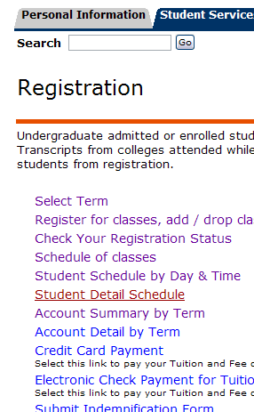
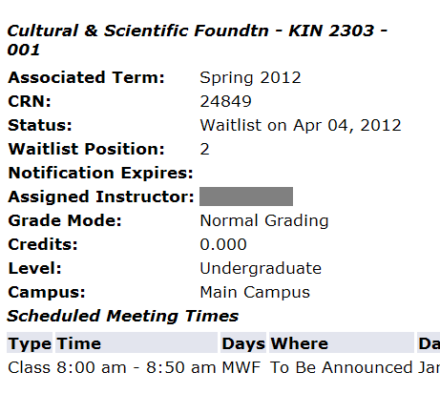
Waitlist Position
Current position on the waitlist can be viewed by the student under Student Detail Schedule.

Slide 11
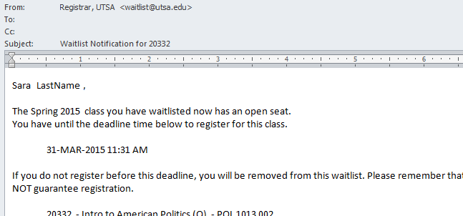
Waitlist Notification
If a seat becomes available in the class, the student next in line will be sent a notification to their preferred email address, as selected in ASAP. Notifications are sent when:
a student registered for the course drops.
the enrollment maximum for the class is raised.
a previous notification expires and is removed.
If notified, they must register themselves for the waitlisted class before the deadline time listed in the email.

Slide 12
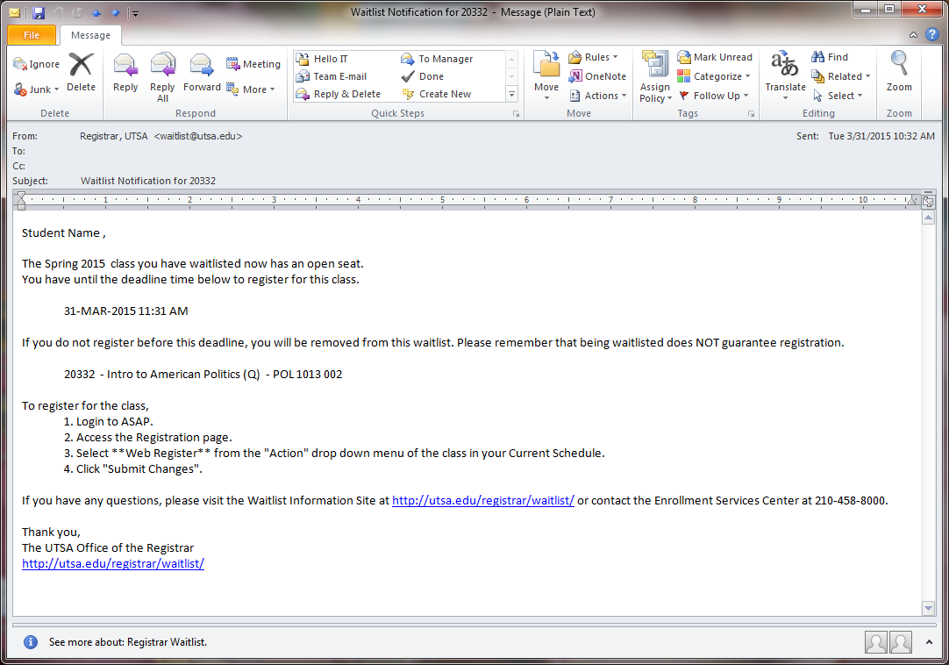
Waitlist Notification
Example of waitlist notification email sent to student.

Slide 13
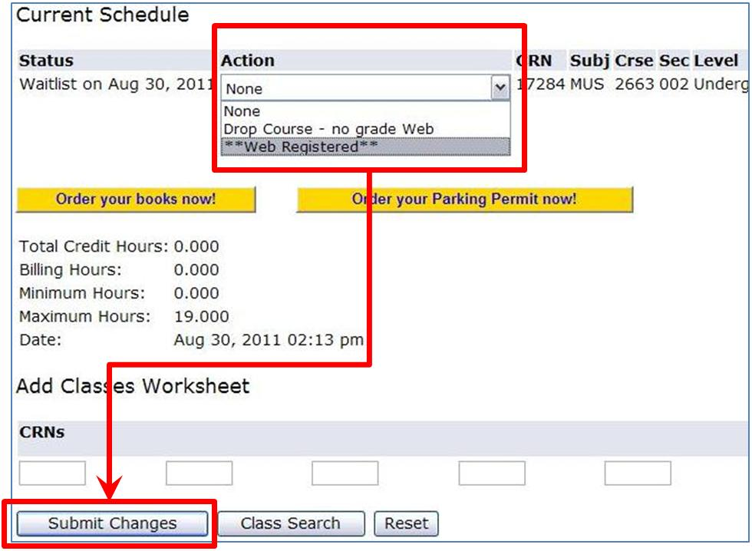
Registering from Waitlist
To register once receiving a notification the student will…
Login to ASAP, and access Registration.
Under the Current Schedule, find the waitlisted class they have been notified about.
Select **Web Registered** from the drop-down list under Action for the class.
Click the Submit Changes button.

Slide 14
Registering from Waitlist
If they have been successfully registered for the class, the Current Schedule will show **Web Registered** .
Being on a class waitlist does not guarantee successful registration. The student has to be eligible to take the class.
If the student receives any Registration Add Errors or has any Holds preventing registration, they will need to clear these before they will be able to register for the class, even if they have been notified that a seat is available.

Slide 15
Watch Out!
Holds – Holds that prevent registration will also prevent a student from getting on a waitlist AND registering from the waitlist, even if they have received their notification.
Drops – Students should be careful adjusting their registered schedule. Dropping a class with a waitlist will immediately send a notification to the next person on the waitlist.
Prerequisites – Students must meet prerequisites prior to getting on the waitlist and/or registering for the class.
Other Restrictions/Errors – Students should review the course notes, catalog, and their schedule to make sure they are eligible to register for the class, even if they can waitlist for it.

Slide 16
Staff view of Waitlisting – Scheduling

Slide 17
Waitlist Classes
Per GRIP/Provost, most sections should get a waitlist.
Exceptions do apply (list).
Per GRIP/Provost, waitlists should be “unlimited”. In Banner, this means 999.
Registrar will handle adding WLs to classes.

Slide 18
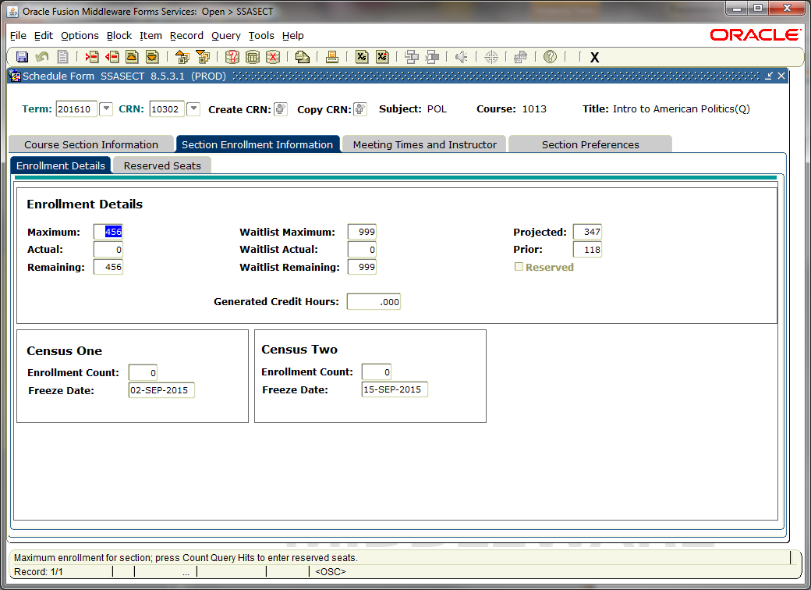
Creating a Waitlist
SSASECT
Section Enrollment Information tab
Enter Waitlist Maximum of 999
Save

Slide 19
Waitlist Schedule Changes
Changing Waitlisted Classes During Registration…
Raising Enrollment Max will IMMEDIATELY send notifications to appropriate waitlisters.
Lowering Enrollment Max when there is a pending notification will prevent the notified student(s) from registering.
When cancelling a WL class, remove the waitlisters FIRST.

Slide 20
Waitlist Schedule Changes
Lowering Enrollment Max can also show up as negative availability on the class schedule. Anyone on the waitlist will have to wait until availability is positive again before they have the chance to be offered a seat.

Slide 21
Staff view of Waitlisting – Registration

Slide 22
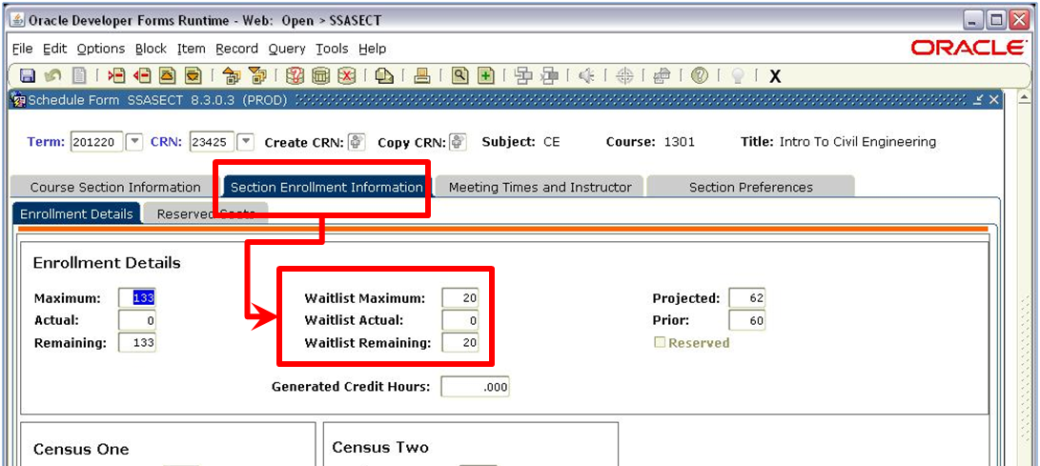
Waitlist Enrollment
To Check Current WL Enrollment
SSASECT
Section Enrollment Information tab
Waitlist fields
Also viewable in SSASECQ

Slide 23
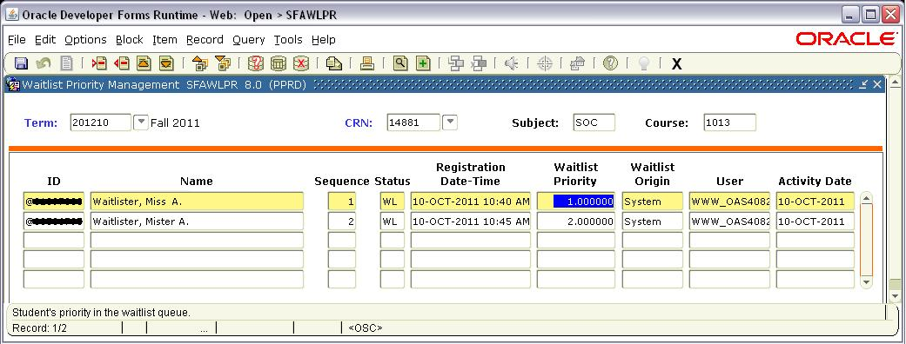
Checking Status of Waitlist
SFAWLPR – Waitlist Priority Management
Shows where a student is on the waitlist for a CRN, provided they have NOT been notified and the class is NOT cross listed.
The smaller the number in Waitlist Priority, the closer to the top of the list they are.
Priority is not necessarily consecutive.

Slide 24
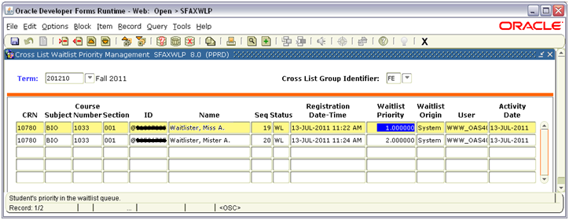
Checking Status of Waitlist
SFAXWLP – Cross List Waitlist Priority Management
Similar to SFAWLPR: shows where a student is on the waitlist for a CRN, provided they have NOT been notified and the class IS cross listed.

Slide 25
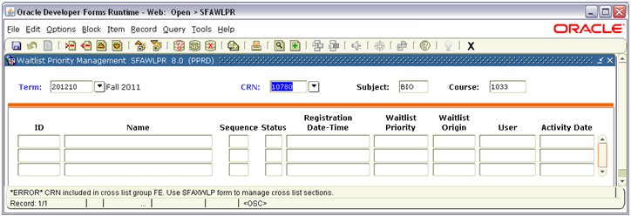
Checking Status of Waitlist
SFAXWLP – Cross List Waitlist Priority Management
Start with SFAWLPR. If the class is cross listed, you will be notified at the bottom of the screen; it will also tell you the Cross List Group Identifier, for use on SFAXWLP.

Slide 26
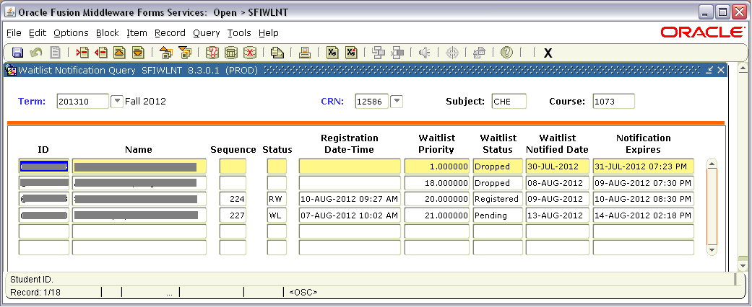
Checking Status of Waitlist
SFIWLNT – Waitlist Notification Query
Shows if a notification has been sent for a student on a waitlist, the current waitlist status, and the notification expiration date/time.
“Dropped” waitlist status can mean the student dropped from the waitlist after being notified, or the notification expired and removed.
Priority is not necessarily consecutive & does not relate to Priority in other forms.

Slide 27
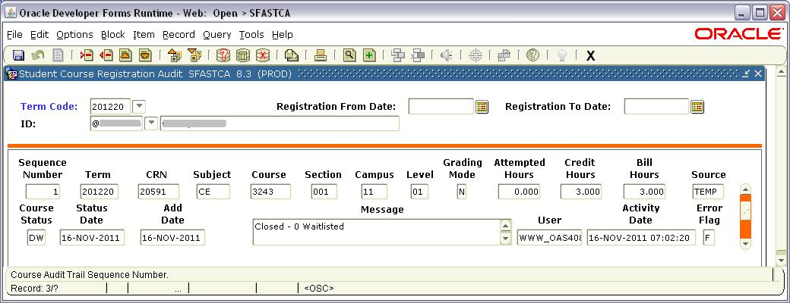
Student Status on Waitlist
SFASTCA – Student Course Registration Audit
Shows waitlist error during registration

Slide 28
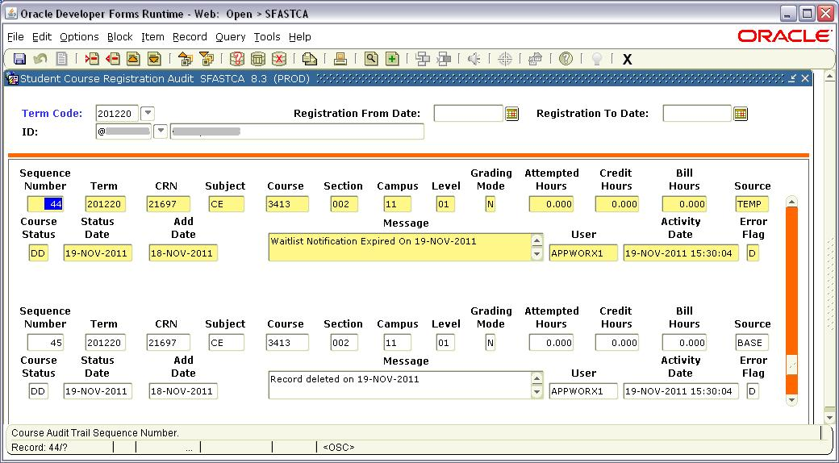
Student Status on Waitlist
SFASTCA – Student Course Registration Audit
Shows if waitlist registration removed due to expired notification

Slide 29
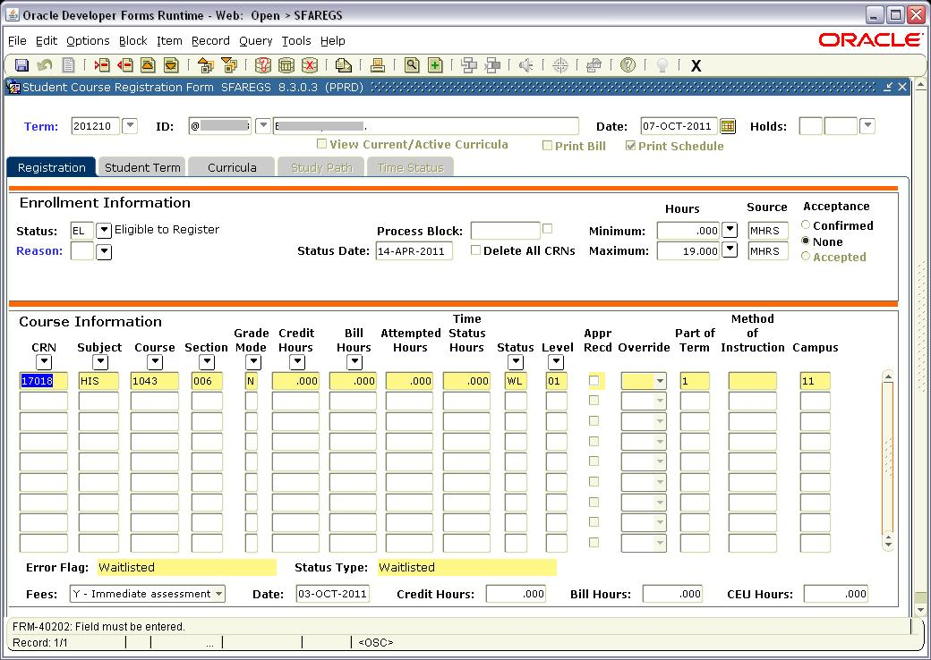
Waitlisting by Staff
Waitlisted classes will appear in SFAREGS
Look like a non-credit registration
New “WL” status code (available only while WL turned on)

Slide 30
Waitlisting by Staff
If you are registering a student into a class and a waitlist error comes up, either:
Add the student to the WL.
Cancel the registration attempt. If possible, do not DC the class as this will prevent the student from waitlisting themselves in ASAP.
DO NOT OVERRIDE A WAITLIST ERROR.

Slide 31
Waitlisting by Staff
DO NOT OVERRIDE A WAITLIST ERROR.
Overriding a waitlist error pushes the student ahead of everyone in line.
If a notification is pending, overriding an error could “steal” a seat from a notified student, preventing them from registering.
If the enrollment maximum is equal to the room capacity, overriding the waitlist error could break fire code.

Slide 32
Waitlisting by Staff
DO NOT OVERRIDE A WAITLIST ERROR.
Reports will be run to find waitlist overrides.
The Registrar’s Office will contact anyone who overrides a waitlist error.
We will send a follow-up email to the staff and their supervisor.
The staff will have to correct the error and contact any affected students.

Slide 33
Waitlisting by Staff
If a student wants to be added to a waitlist, they should do so through ASAP.
However, if necessary, registration into the waitlist can be done through SFAREGS.
Enter CRN, tab to populate, and save.

Slide 34
Waitlisting by Staff
Waitlist error will come up under Message. Do not override this error. Either add the student to the WL or cancel the registration attempt. If cancelling the registration attempt, do NOT change the status code to DC as this will prevent the student from waitlisting for this class on ASAP.

Slide 35
Waitlisting by Staff
If WL is not full, change the status from RE to WL.
Save and save. If there are no other errors preventing student from being added to the WL, it will save as a waitlisted class & the student will join the waitlist.
Banner will take over. If a seat becomes available, Banner will send the notification & the student will have to register on ASAP.

Slide 36
Waitlisting by Staff
If you know/suspect a waitlisted student will have errors if they are able to register, provide appropriate overrides in SFASRPO.
Graduate students can waitlist for Undergrad classes, provided the level restriction is overridden in SFAREGS when first waitlisted.
HOLDS count! Even if you override a hold to add a student to a waitlist in SFAREGS, the student will be unable to register if notified if the hold is still active.
If you are modifying a student’s record for waitlist reasons, add a comment in SPACMNT.

Slide 37
Common Waitlist Issues
Emails – Students do NOT receive an email when they get on a waitlist – only if a seat becomes available.
Missed Notification Time – If a student does not register during their notification timeframe, they will be automatically dropped from the waitlist. They can register again for the waitlist, but they will start at the end of the list.
Submit Changes – A student is not on the waitlist until they have selected Waitlist and pressed Submit on the Add/Drop page in ASAP. Until the waitlisted class shows under Current Schedule, they are NOT on the waitlist.

Slide 38
Common Waitlist Issues
Register – A student has to register for the class through ASAP once notified. Registration from the waitlist is not automatic.
End of WL – Waitlisting ends the last day to add a class through ASAP (usually the 5th class day). HOWEVER, the last day to get on the waitlist is the day before the last day to add a class, and the last notifications will go out before noon on

Slide 39
Questions? Feedback? Contact us! Office of the Registrar Waitlist Project Team www.UTSA.edu/Registrar/Waitlist/ Waitlist@UTSA.edu 458-7070

